Slide 1
Chemical Vapour Deposition
Just starting this early to wrap my head around all the equations and such.

Slide 2
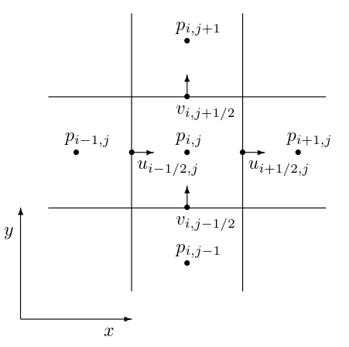
Eulerian Fluid Simulations
Discretized Staggered Grid
Cells store properties
  Pressure
  Temperature
  Concentration
https://quangduong.me/notes/eulerian_fluid_sim_p1/

Slide 3
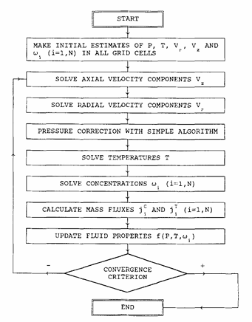
Method ordering
SIMPLE Algorithm
  Semi-Implicit Method for Pressure-Linked Equations

Slide 4

Momentum Equations
Continuity Equation
  $∇∙ρv=0$
  $∇∙v=\frac{1}{r}\frac{δ\left(rv_{r}\right)}{δr}+\frac{δv_{z}}{δz}=0$
Navier Stokes
  $∇∙\left(ρvv\right)=∇∙τ−∇P+ρg$
  $τ=μ\left(∇v+∇v^{T}\right)+\left(k−\frac{2}{3}μ\right)\left(∇∙v\right)∙I$

Slide 5
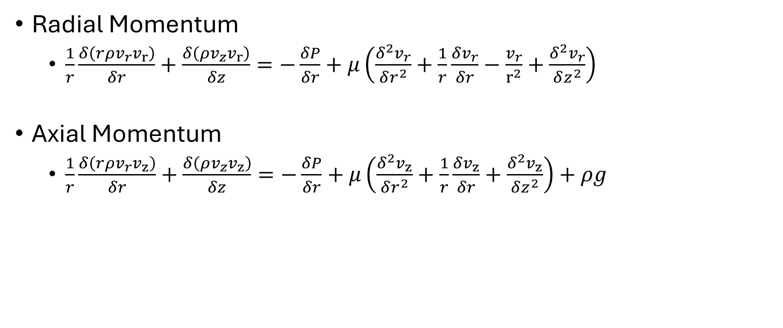
Momentum Equations
Radial Momentum
  $\frac{1}{r}\frac{δ\left(rρv_{r}v_{r}\right)}{δr}+\frac{δ\left(ρv_{z}v_{r}\right)}{δz}=−\frac{δP}{δr}+μ\left(\frac{δ^{2}v_{r}}{δr^{2}}+\frac{1}{r}\frac{δv_{r}}{δr}−\frac{v_{r}}{r^{2}}+\frac{δ^{2}v_{r}}{δz^{2}}\right)$
Axial Momentum
  $\frac{1}{r}\frac{δ\left(rρv_{r}v_{z}\right)}{δr}+\frac{δ\left(ρv_{z}v_{z}\right)}{δz}=−\frac{δP}{δr}+μ\left(\frac{δ^{2}v_{z}}{δr^{2}}+\frac{1}{r}\frac{δv_{z}}{δr}+\frac{δ^{2}v_{z}}{δz^{2}}\right)+ρg$

Slide 6
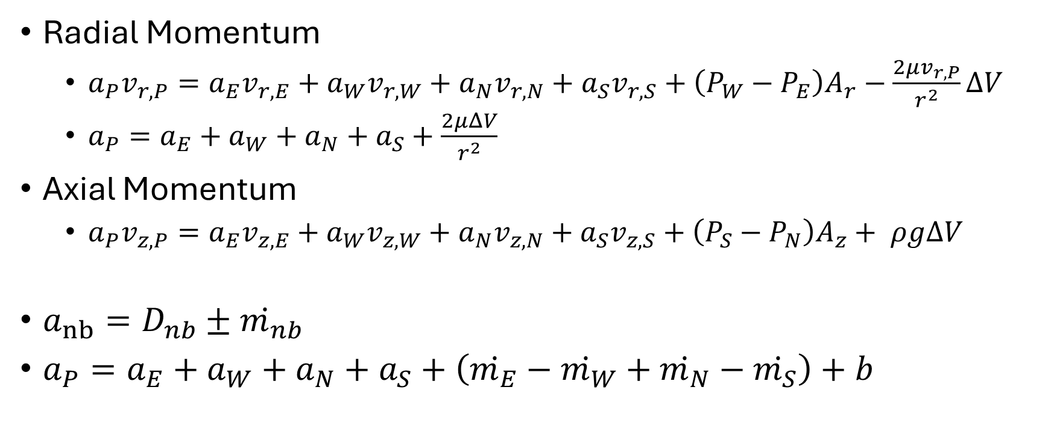
Momentum Equations Discretized
Radial Momentum
  $a_{P}v_{r,P}=a_{E}v_{r,E}+a_{W}v_{r,W}+a_{N}v_{r,N}+a_{S}v_{r,S}+\left(P_{W}−P_{E}\right)A_{r}−\frac{2μv_{r,P}}{r^{2}}ΔV$
  $a_{P}=a_{E}+a_{W}+a_{N}+a_{S}+\frac{2μΔV}{r^{2}}$
Axial Momentum
  $a_{P}v_{z,P}=a_{E}v_{z,E}+a_{W}v_{z,W}+a_{N}v_{z,N}+a_{S}v_{z,S}+\left(P_{S}−P_{N}\right)A_{z}+ ρgΔV$
$a_{nb}=D_{nb}±ṁ_{nb}$
$a_{P}=a_{E}+a_{W}+a_{N}+a_{S}+\left(ṁ_{E}−ṁ_{W}+ṁ_{N}−ṁ_{S}\right)+b$

Slide 7

Pressure Correction with Line TDMA
Axial
  $a_{E}=\frac{1}{δr^{2}}+\frac{1}{2rδr}$
  $a_{W}=\frac{1}{δr^{2}}−\frac{1}{2rδr}$
  $a_{N}=a_{S}=\frac{1}{δr^{2}}$
  $a_{P}=a_{E}+a_{W}+a_{N}+a_{S}$
(1,1) | (1,2) | (1,3) | (1,4) | (1,5) | (1,6)
(2,1) | (2,2) | (2,3) | (2,4) | (2,5) | (2,6)
(3,1) | (3,2) | (3,3) | (3,4) | (3,5) | (3,6)
(4,1) | (4,2) | (4,3) | (4,4) | (4,5) | (4,6)
(5,1) | (5,2) | (5,3) | (5,4) | (5,5) | (5,6)

Slide 8
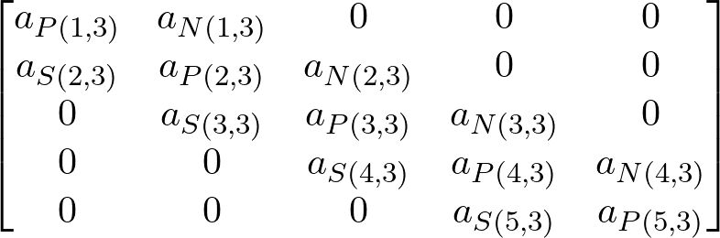
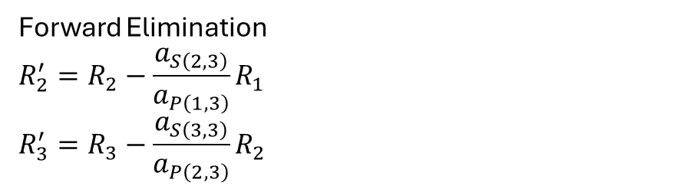
Pressure Correction with Line TDMA
(1,1) | (1,2) | (1,3) | (1,4) | (1,5) | (1,6)
(2,1) | (2,2) | (2,3) | (2,4) | (2,5) | (2,6)
(3,1) | (3,2) | (3,3) | (3,4) | (3,5) | (3,6)
(4,1) | (4,2) | (4,3) | (4,4) | (4,5) | (4,6)
(5,1) | (5,2) | (5,3) | (5,4) | (5,5) | (5,6)
Forward Elimination
$$R_{2}^{′}=R_{2}−\frac{a_{S\left(2,3\right)}}{a_{P\left(1,3\right)}}R_{1}$$
$$R_{3}^{′}=R_{3}−\frac{a_{S\left(3,3\right)}}{a_{P\left(2,3\right)}}R_{2}$$

Slide 9
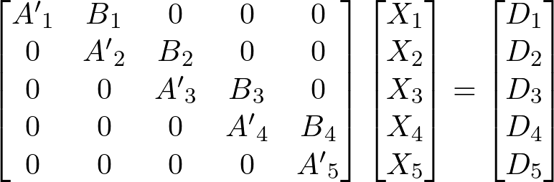
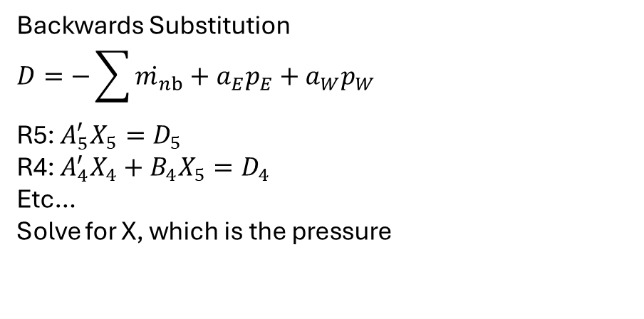
Pressure Correction with Line TDMA
(1,1) | (1,2) | (1,3) | (1,4) | (1,5) | (1,6)
(2,1) | (2,2) | (2,3) | (2,4) | (2,5) | (2,6)
(3,1) | (3,2) | (3,3) | (3,4) | (3,5) | (3,6)
(4,1) | (4,2) | (4,3) | (4,4) | (4,5) | (4,6)
(5,1) | (5,2) | (5,3) | (5,4) | (5,5) | (5,6)
Backwards Substitution
$$D=−\sum{ṁ_{nb}}+a_{E}p_{E}+a_{W}p_{W}$$
R5: $A_{5}^{′}X_{5}=D_{5}$
R4: $A_{4}^{′}X_{4}+B_{4}X_{5}=D_{4}$
Etc…
Solve for X, which is the pressure

